Slide 1
Resolving Complaints
Cason Wight
Other Collaborators: Daniel Sheanshang and Devin Johnson

Slide 2



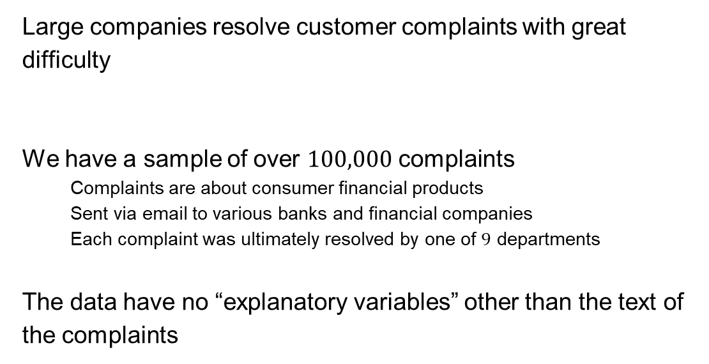
Background
Large companies resolve customer complaints with great difficulty
We have a sample of over $100,000$ complaints
Complaints are about consumer financial products
Sent via email to various banks and financial companies
Each complaint was ultimately resolved by one of $9$ departments
The data have no “explanatory variables” other than the text of the complaints

Slide 3
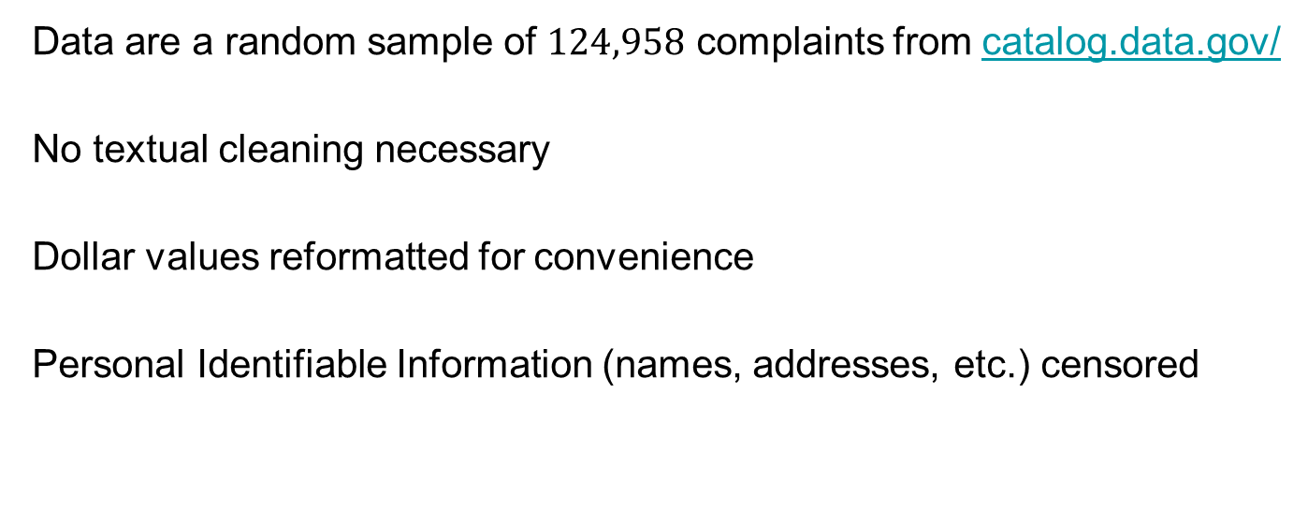
Current Data Status
Data are a random sample of $124,958$ complaints from catalog.data.gov/
No textual cleaning necessary
Dollar values reformatted for convenience
Personal Identifiable Information (names, addresses, etc.) censored

Slide 4
Example Complaint
“I monitor my credit report, more frequently now as we're attempting to buy our first house. A collection notice was filed for the amount of {$3900.00}. We have received no notification of this debt, no verification of this debt, and consequently no notice of right to dispute this debt.”
Complaint resolved by Debt Collection

Slide 5
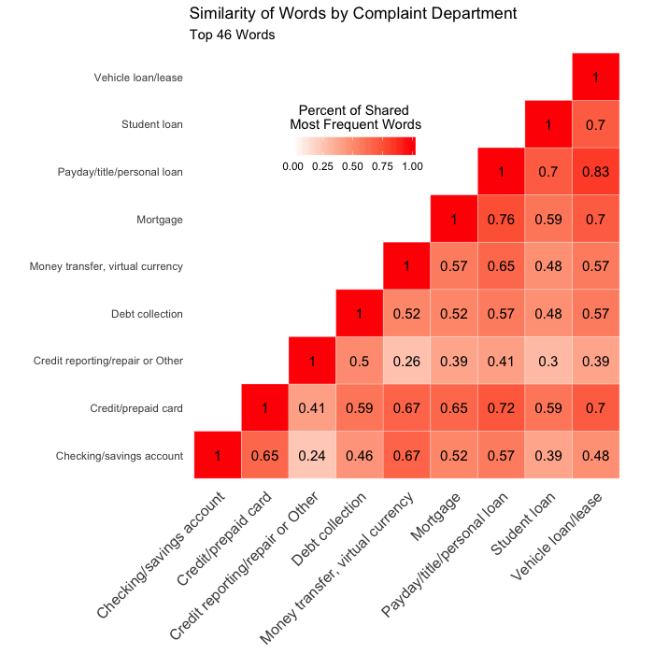
Data issues/EDA
Multi-categorical response requires classification
Data set has no explanatory variables
Complaints require processing

Slide 6
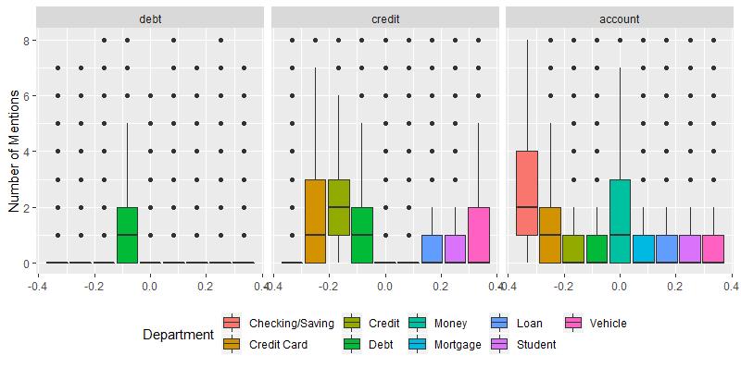
Number of Word Mentions

Slide 7
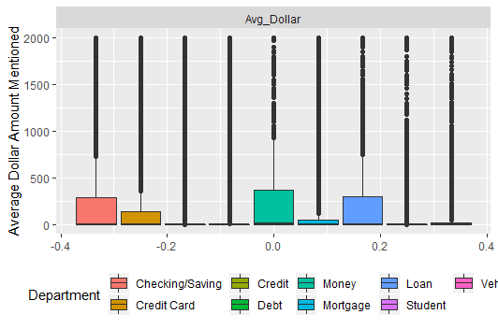
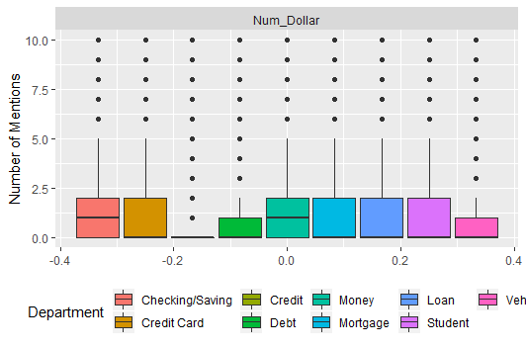
Monetary Amounts Mentioned

Slide 8
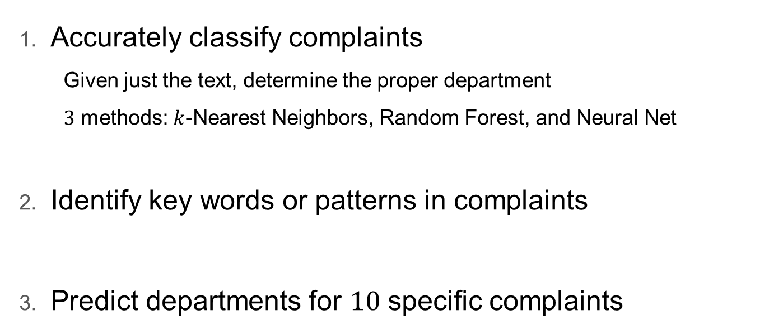
Goals
Accurately classify complaints
Given just the text, determine the proper department
$3$ methods: $k$-Nearest Neighbors, Random Forest, and Neural Net
Identify key words or patterns in complaints
Predict departments for $10$ specific complaints

Slide 9



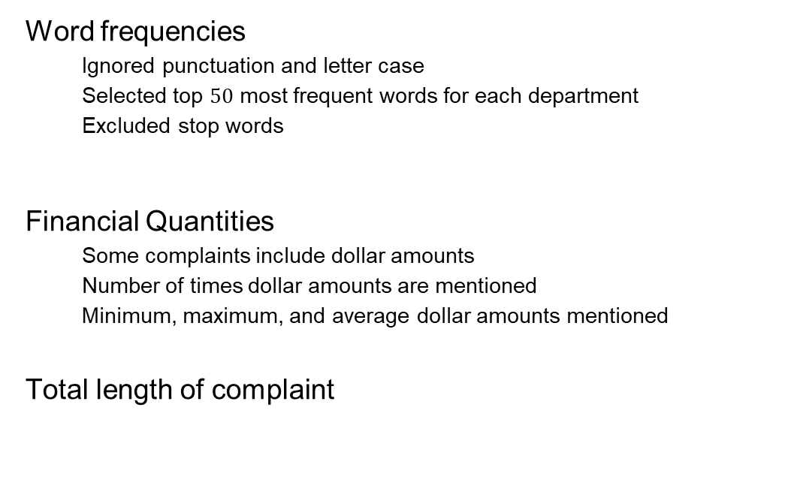
Design of the Inputs
Word frequencies
Ignored punctuation and letter case
Selected top $50$ most frequent words for each department
Excluded stop words
Financial Quantities
Some complaints include dollar amounts
Number of times dollar amounts are mentioned
Minimum, maximum, and average dollar amounts mentioned
Total length of complaint

Slide 10
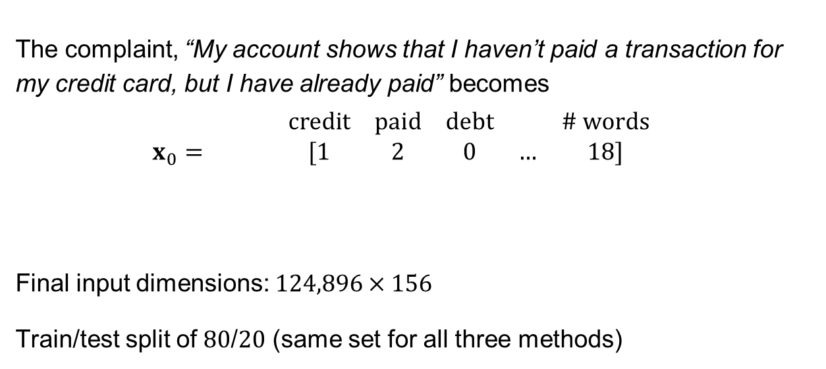
Design of the Inputs
The complaint, “My account shows that I haven’t paid a transaction for my credit card, but I have already paid” becomes
$$\begin{matrix} & & & credit & paid & debt & & \# words & \\ x_{0}= & & & [1 & 2 & 0 & … & 18] & \end{matrix}$$
Final input dimensions: $124,896×156$
Train/test split of $80$/$20$ (same set for all three methods)

Slide 11
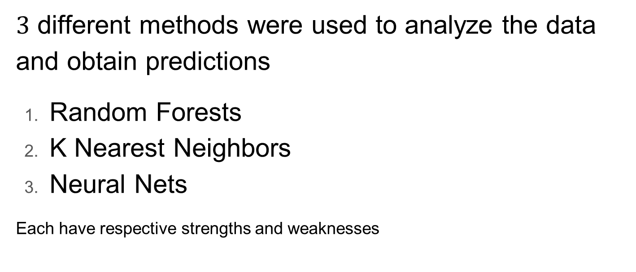
Methodology
$3$ different methods were used to analyze the data and obtain predictions
Random Forests
K Nearest Neighbors
Neural Nets
Each have respective strengths and weaknesses

Slide 12
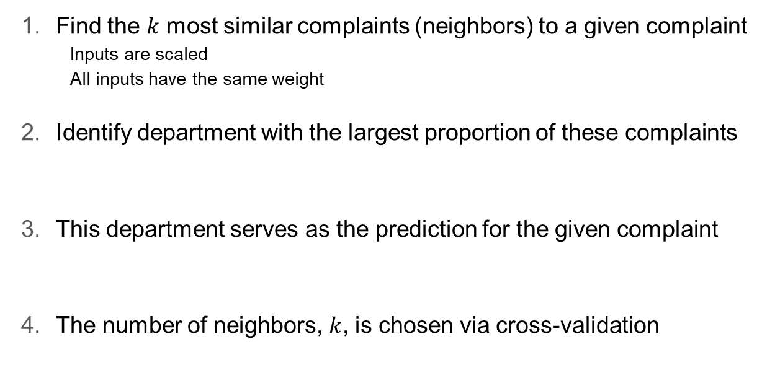
$k$-Nearest Neighbors (KNN)
Find the $k$ most similar complaints (neighbors) to a given complaint
Inputs are scaled
All inputs have the same weight
Identify department with the largest proportion of these complaints
This department serves as the prediction for the given complaint
The number of neighbors, $k$, is chosen via cross-validation

Slide 13
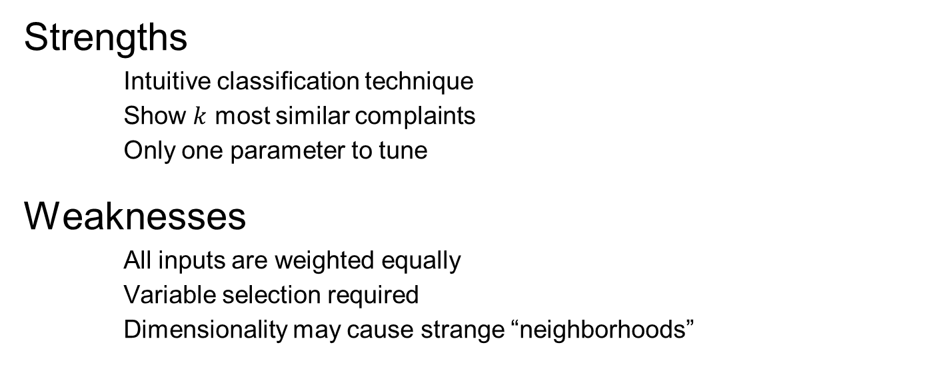
KNN (Cont.)
Strengths
Intuitive classification technique
Show $k$ most similar complaints
Only one parameter to tune
Weaknesses
All inputs are weighted equally
Variable selection required
Dimensionality may cause strange “neighborhoods”

Slide 14
Random Forest Algorithm
Obtain bootstrap samples from inputs
For each sample, construct a classification tree
For a single complaint, predict department using all trees
Prediction for the complaint is the most predicted department

Slide 15
Random Forest (Cont.)
Strengths
Few parameters to tune
Trees are random and uncorrelated
Reveals variable importance
Weaknesses
Computation time
Lack of interpretability

Slide 16
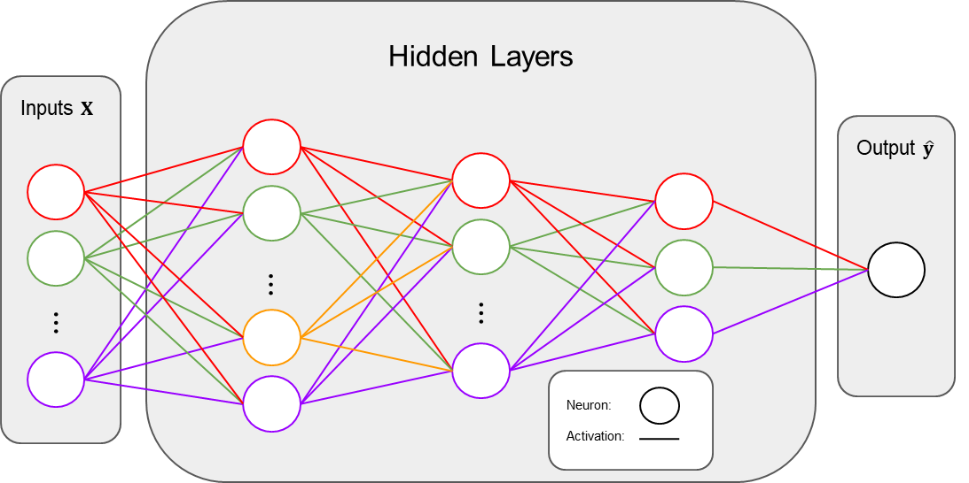
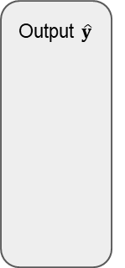
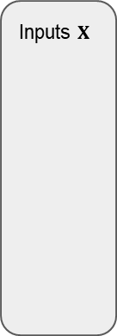
Neural Nets
Hidden Layers
Inputs $X$
Output $\hat{y}$
⋯
⋯
⋯
⋯
Neuron:
Activation:

Slide 17
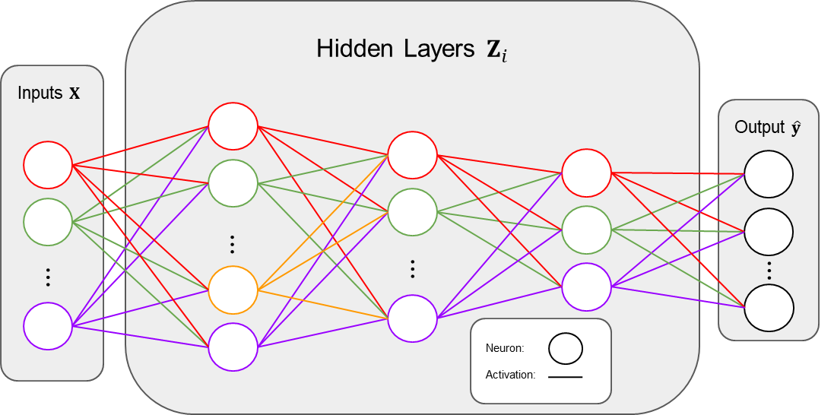
“Fitting” a Neural Net
Center/scale the data
Construct the neural net framework
Update best parameters via back-propagation
Calculates weights and coefficients
Loss function guides adjustments
Process is called gradient descent
Tune the hyperparameters
Number of layers/neurons
Activation functions
Learning rate

Slide 18
Neural Nets (Cont.)
Strengths
Highly flexible
Known to achieve excellent prediction
Weaknesses
Inference is impossible
Tuning is a challenge
Massive amount of data required
Computation time can be a burden

Slide 19
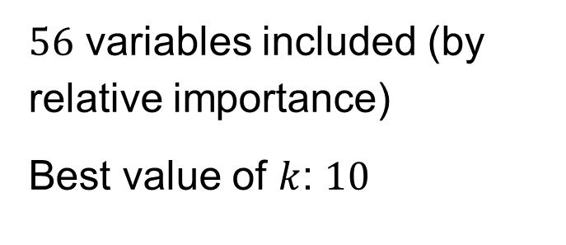
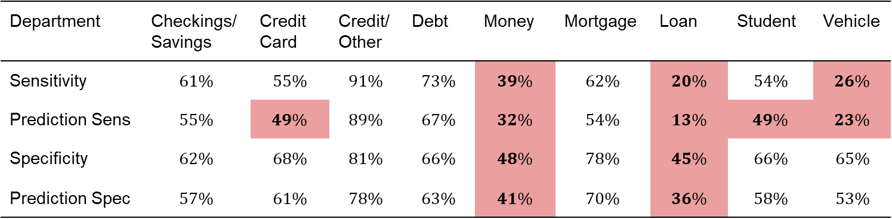
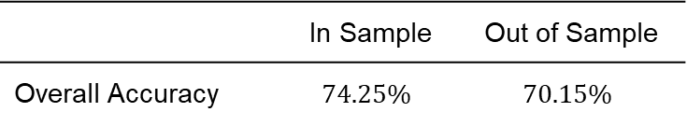
Model Fit – KNN
$56$ variables included (by relative importance)
Best value of $k$: $10$
 | In Sample | Out of Sample
Overall Accuracy | $$74.25\%$$ | $$70.15\%$$
Department | Checkings/Savings | Credit Card | Credit/ Other | Debt | Money | Mortgage | Loan | Student | Vehicle
Sensitivity | $$61\%$$ | $$55\%$$ | $$91\%$$ | $$73\%$$ | $$39\%$$ | $$62\%$$ | $$20\%$$ | $$54\%$$ | $$26\%$$
Prediction Sens | $$55\%$$ | $$49\%$$ | $$89\%$$ | $$67\%$$ | $$32\%$$ | $$54\%$$ | $$13\%$$ | $$49\%$$ | $$23\%$$
Specificity | $$62\%$$ | $$68\%$$ | $$81\%$$ | $$66\%$$ | $$48\%$$ | $$78\%$$ | $$45\%$$ | $$66\%$$ | $$65\%$$
Prediction Spec | $$57\%$$ | $$61\%$$ | $$78\%$$ | $$63\%$$ | $$41\%$$ | $$70\%$$ | $$36\%$$ | $$58\%$$ | $$53\%$$

Slide 20
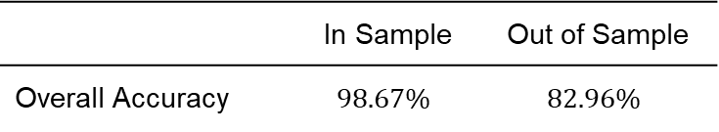
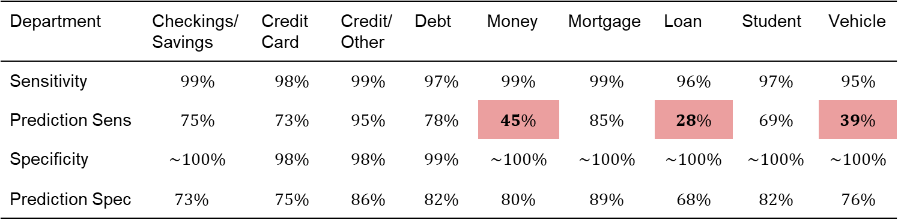
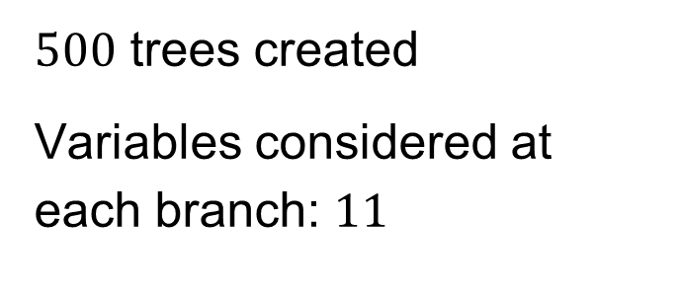
Model Fit – Random Forest
$500$ trees created
Variables considered at each branch: $11$
 | In Sample | Out of Sample
Overall Accuracy | $$98.67\%$$ | $$82.96\%$$
Department | Checkings/Savings | Credit Card | Credit/ Other | Debt | Money | Mortgage | Loan | Student | Vehicle
Sensitivity | $$99\%$$ | $$98\%$$ | $$99\%$$ | $$97\%$$ | $$99\%$$ | $$99\%$$ | $$96\%$$ | $$97\%$$ | $$95\%$$
Prediction Sens | $$75\%$$ | $$73\%$$ | $$95\%$$ | $$78\%$$ | $$45\%$$ | $$85\%$$ | $$28\%$$ | $$69\%$$ | $$39\%$$
Specificity | $$\sim 100\%$$ | $$98\%$$ | $$98\%$$ | $$99\%$$ | $$\sim 100\%$$ | $$\sim 100\%$$ | $$\sim 100\%$$ | $$\sim 100\%$$ | $$\sim 100\%$$
Prediction Spec | $$73\%$$ | $$75\%$$ | $$86\%$$ | $$82\%$$ | $$80\%$$ | $$89\%$$ | $$68\%$$ | $$82\%$$ | $$76\%$$

Slide 21
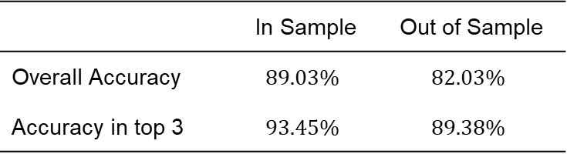
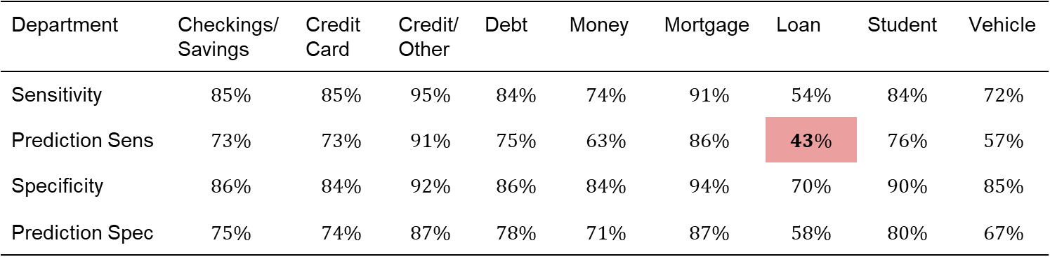
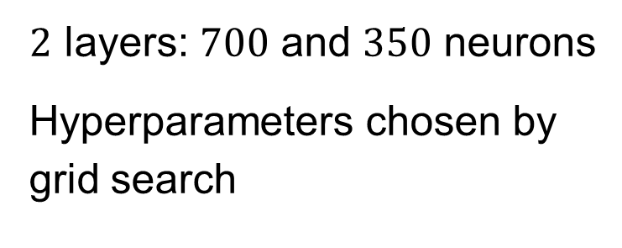
Model Fit – Neural Net
$2$ layers: $700$ and $350$ neurons
Hyperparameters chosen by grid search
 | In Sample | Out of Sample
Overall Accuracy | $$89.03\%$$ | $$82.03\%$$
Accuracy in top 3 | $$93.45\%$$ | $$89.38\%$$
Department | Checkings/Savings | Credit Card | Credit/ Other | Debt | Money | Mortgage | Loan | Student | Vehicle
Sensitivity | $$85\%$$ | $$85\%$$ | $$95\%$$ | $$84\%$$ | $$74\%$$ | $$91\%$$ | $$54\%$$ | $$84\%$$ | $$72\%$$
Prediction Sens | $$73\%$$ | $$73\%$$ | $$91\%$$ | $$75\%$$ | $$63\%$$ | $$86\%$$ | $$43\%$$ | $$76\%$$ | $$57\%$$
Specificity | $$86\%$$ | $$84\%$$ | $$92\%$$ | $$86\%$$ | $$84\%$$ | $$94\%$$ | $$70\%$$ | $$90\%$$ | $$85\%$$
Prediction Spec | $$75\%$$ | $$74\%$$ | $$87\%$$ | $$78\%$$ | $$71\%$$ | $$87\%$$ | $$58\%$$ | $$80\%$$ | $$67\%$$

Slide 22
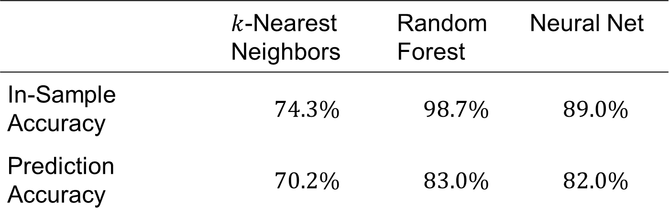
Classification Accuracy
 | $k$-Nearest Neighbors | Random Forest | Neural Net
In-Sample Accuracy | $$74.3\%$$ | $$98.7\%$$ | $$89.0\%$$
Prediction Accuracy | $$70.2\%$$ | $$83.0\%$$ | $$82.0\%$$

Slide 23
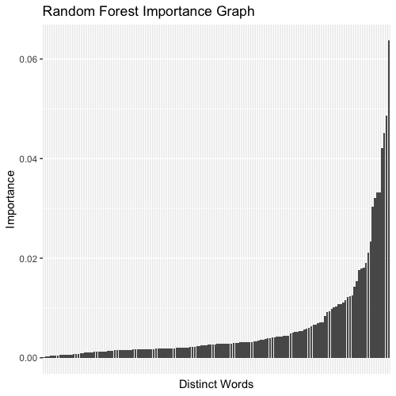
Random Forest Variable Importance
Most Important | Least Important
debt | block
credit | plan
report | school
card | lease
Complaint Length | finance
reporting | america
mortgage | forbearance
loan | dealership

Slide 24
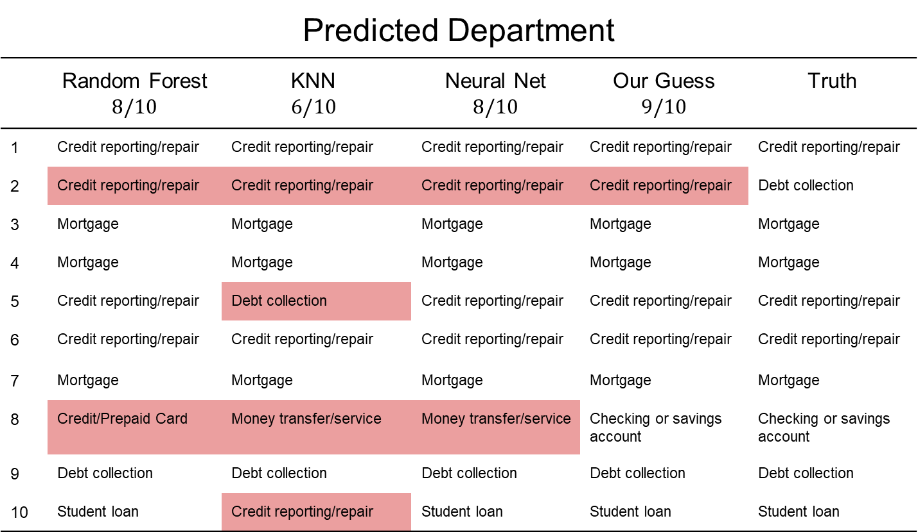
Predicted Department
 | Random Forest $$8/10$$ | KNN $$6/10$$ | Neural Net $$8/10$$ | Our Guess $$9/10$$ | Truth
1 | Credit reporting/repair | Credit reporting/repair | Credit reporting/repair | Credit reporting/repair | Credit reporting/repair
2 | Credit reporting/repair | Credit reporting/repair | Credit reporting/repair | Credit reporting/repair | Debt collection
3 | Mortgage | Mortgage | Mortgage | Mortgage | Mortgage
4 | Mortgage | Mortgage | Mortgage | Mortgage | Mortgage
5 | Credit reporting/repair | Debt collection | Credit reporting/repair | Credit reporting/repair | Credit reporting/repair
6 | Credit reporting/repair | Credit reporting/repair | Credit reporting/repair | Credit reporting/repair | Credit reporting/repair
7 | Mortgage | Mortgage | Mortgage | Mortgage | Mortgage
8 | Credit/Prepaid Card | Money transfer/service | Money transfer/service | Checking or savings account | Checking or savings account
9 | Debt collection | Debt collection | Debt collection | Debt collection | Debt collection
10 | Student loan | Credit reporting/repair | Student loan | Student loan | Student loan

Slide 25
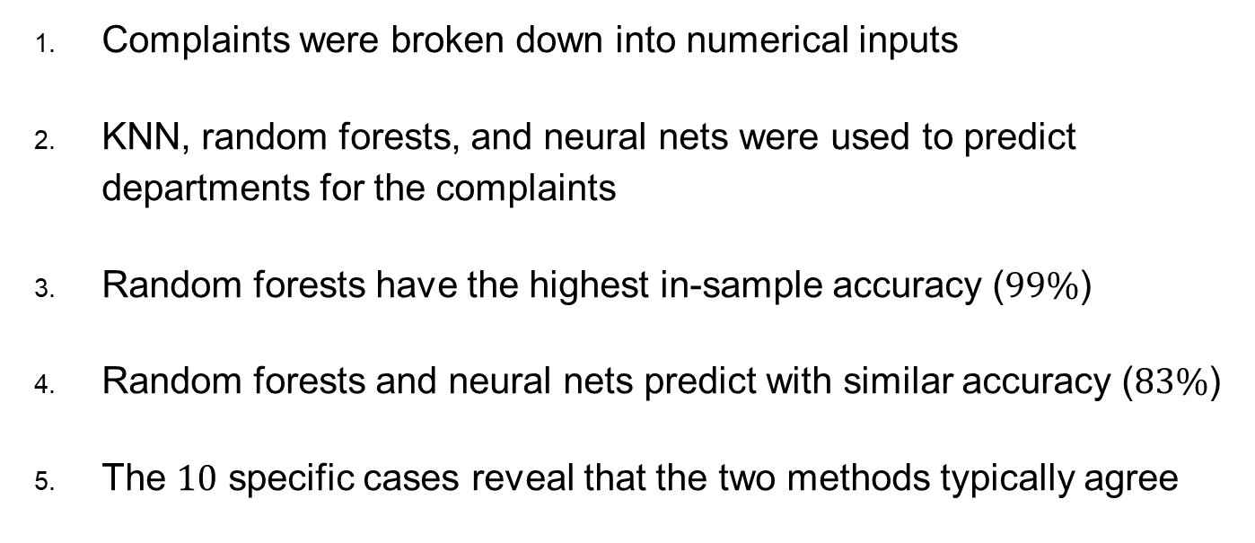
Conclusion
Complaints were broken down into numerical inputs
KNN, random forests, and neural nets were used to predict departments for the complaints
Random forests have the highest in-sample accuracy ($99\%$)
Random forests and neural nets predict with similar accuracy ($83\%$)
The $10$ specific cases reveal that the two methods typically agree

Slide 26
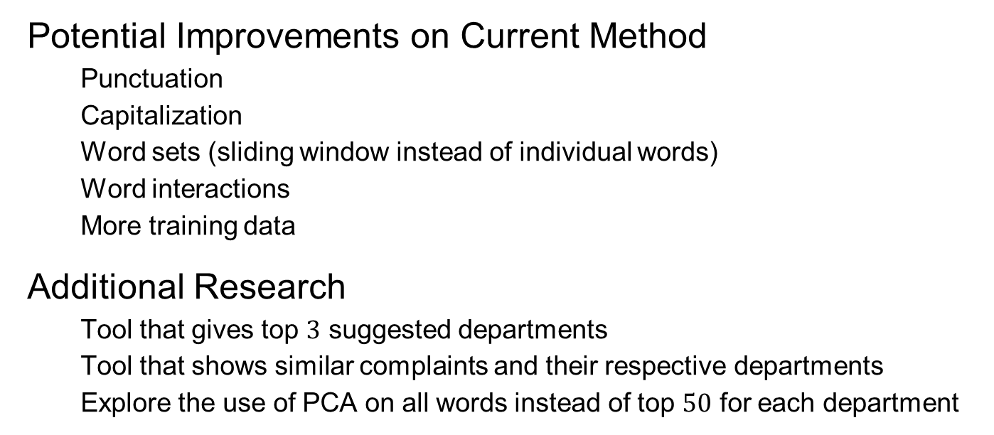
Future Work
Potential Improvements on Current Method
Punctuation
Capitalization
Word sets (sliding window instead of individual words)
Word interactions
More training data
Additional Research
Tool that gives top $3$ suggested departments
Tool that shows similar complaints and their respective departments
Explore the use of PCA on all words instead of top $50$ for each department

Slide 27
Appendix: Complaints 1-3
XXXX XXXX/ XXXX XXXX #XXXX is reporting a collection to my account that is in error. This collection was paid off over a year ago and is still reporting a balance, it is negatively effecting my scores and it should not have a balance reporting. I would like it removed immediately. (Credit Reporting/Repair)
XXXX are reporting unverified information on my credit report on Fed Loan Servicing # XXXX and the below creditors and this is causing injury to my person as I am not able to acquire new credit based on these false invalidated claims. US Dept of Ed/XXXX # XXXX XXXX XXXX # XXXX XXXX XXXX XXXX {$270.00} XXXX XXXX XXXX # XXXX (Debt Collection)
PREVIOUS OWNER XXXX XXXX THIS IS A FOLLOW UP FOR CASE # XXXX FILED WITH CONSUMER REPORT XX/XX/XXXX ALONG WITH CALIBER HOME LOANS RESPOSE LETTER, CLOSING COMPANY HAD CONTACTED CALIBER SINCE XX/XX/XXXX WITH SLOW TO NO RESPONSE. PER CALIBER REQUEST IN WHICH ALREADY BEEN PROVIDED BY CLOSING COMPANY. DOCUMENTS ENCLOSED ARE XXXX XXXX XXXX ACCOUNT # XXXX ( COPIES ENCLOSED ) ONE LOAN UNDER XXXX - XXXX XXXX XXXX XXXX XXXX XXXX, OK.XXXX HAS 7 PROPERTIES INSIDE THIS LOAN, ONLY ONE PROPERTY BEEN RELEASED XXXX - XXXX XXXX XXXX XXXX. XXXX XXXX, OK. XXXX THIS LOAN WAS SOLD BY XXXX XXXX XXXX TO CALIBER HOME LOANS XX/XX/XXXX. CALIBER LOAN # XXXX WHICH HAS SAME 7 PROPERTIES. PLEASE RELEASE REMAINIG 6 ADDRESSES PER COPIES PROVIDED. THANK YOU (Mortgage)

Slide 28
Appendix: Complaints 4-5
I am writing because as a client of Bank of America, N.A. they claim to be able to have the right to foreclose by the California Declaration ( Civ. Code 2923.55 ( b ) ( 2 ) ). Their reason for this decision in the letter happened because they have already contacted the borrower to assess the borrowers financial situation and to explore options for the borrower to avoid foreclosure in accordance with the California Declaration ( Civ. Code 2923.55 ( b ) ( 2 ) ). However, prior to this letter I, the client, XXXX XXXX XXXX have sent out three previous Request for Mortgage Assistance Applications to Bank of America, N.A. in the result of having the only option to Short Sale. These Request for Mortgage Assistances which I have sent out in the past have also contained all of my contact information needed to be able to discuss the matters on my current finances, which concludes that there is no excuse to the absent amount of information needed to contact me on such matters. To conclude, the letter of California Declaration ( Civ. Code 2923.55 ( b ) ( 2 ) ) is in short, void because Bank of America, N.A. was able to make initial contact with me and explore more options with me, XXXX XXXX XXXX from the time I sent out the first Request for Mortgage Assistance. Also, the California Declaration ( Civ. Code 2923.55 ( b ) ( 2 ) ) they used was signed and dated on XX/XX/2019, which can not be used for my current Notice of Default which is dated XX/XX/2019. Therefore meaning, that both documents together are not legal and are void to continue forth with the procedures of foreclosure. (Mortgage)
Re : Hard Inquiry/Unverified on my behave. I recently checked my credit reports : XXXX, XXXX, Transunion. I have one Hard Inquiry was made by Company on XX/XX/2017.XXXX XXXX : XXXX XXXX XXXX XXXX, MN XXXX ( XXXX ) XXXX I have called XXXX XXXX XXXX XXXX XXXX in several occasions left messages for the Supervisor to return the call, regarding this matter.NO returned calls.I also contacted XXXX, XXXX, Transunion. (Credit Reporting/Repair)

Slide 29
Appendix: Complaints 6-7
Equifax keeps reporting accounts that are in someone else name and social security number. The following items on the enclosed PDF file are not mine. There is an alternate social that Equifax keeps reporting and can not get it through their head that the alternate social being reported IS NOT MINE and all the creditors have verified this and told me they removed the item, but yet Equifax continues to report it. I have enclosed a printout of the items, every item in YELLOW is NOT MINE, also a copy of the latest three police reports filed. The two addresses in yellow are not mine either. XXXX said they would remove it, XXXX XXXX sent a letter to remove it and yet they appear still on my report. (Credit Reporting/Repair)
Wells Fargo refuses to respond to my previous complaint, which was number XXXX. The complaint was sent to Wells Fargo on XX/XX/XXXX. Currently, there is an auction date of XX/XX/XXXX, and Wells Fargo has not responded to my attorney 's calls. We have been attempting to resolve the pending issue regarding the loan modification approval. I have submitted all documents that Wells Fargo has requested in order to move forward with assuming the existing loan on the subject property ; however, Wells Fargo refuses to cooperate to resolve the issue regarding the approval of the loan modification. Furthermore, Wells Fargo has specified that they do not have to communicate with any of their clients whatsoever. We have been trying to negotiate with Wells Fargo, before they file bankruptcy, and leave their clients in limbo. We are ready to begin making mortgage payments in order to settle the debt on the subject property, but Wells Fargo appears to be very stubborn. The California Attorney General 's office needs to continue investigating this fraudulent and unethical company that has been continuously taking advantage of homeowners. My family and I are ready to resolve this issue, and Wells Fargo needs to negotiate in order to settle this dispute. Finally, there is no unauthorized third party regarding this pending matter. Wells Fargo needs to stop creating fantasies, and deal with this dispute in a sound and reasonable capacity. (Mortgage)

Slide 30
Appendix: Complaints 8-9
This complaint is about Chase Bank. I recieved an over draft this morning for {$150.00}. According to the Chase app. I had {$40.00} in my account as of yesterday, XX/XX/2019, when i withdraw {$120.00} out at the atm. I tried to figure out how this could have happen but only thing i see is my payment to XXXX XXXX for {$200.00} that was placed on friday XX/XX/2019. Now i know for a fact that it was posted to my account which means the money was to be held or taken out. Because the {$200.00} was on the XXXX XXXX credit card the next day. I do not understand how i overdraft my account when i always check my app. I just found out My daughter who is XXXX XXXX is also having this problem. She has a hard time counting her money and she said this has happened to her more then once. (Checking or Savings Account)
Kinum, Inc. ignored my letter ( sent to them within 5 days of their initial communication ) asking them to substantiate their claim that I owed debt. They falsely accused me of owing debt, distorting facts and misrepresenting an agreement I had with a vendor. I sent the letter by certified mail, asking for substantiation of the debt and asking for proof that they had a right to collect it. I know they received it because their employee signed the certified mail receipt. Before responding to me, they contacted my relatives and terrified them. They also contacted me and claimed they never got the letter even though I have signature proof. (Debt Collection)

Slide 31
Appendix: Complaint 10
XXXX XXXX Navient Office of the Customer Advocate XXXX XXXX XXXX, PA XXXX Account # XXXX RE : Income-based repayment plans Account # XXXX Good day, I have received my new IBR payment information, and wish to inform you that you have miscalculated. Last years XXXX income-based repayment amount was XXXX and based on my salary of {$65000.00}. This year, you have raised the supposedly income-based repayment up to {$710.00}? The increase seems excessive, as based on the 10 % of gross income formula the correct amount would be much closer to {$590.00}. Your company has deliberately withheld the necessary information for getting that recalculation done for MONTHS, ignored my letter to do so and ample information regarding my current income, and continued to overcharge me. I am including a new IBR request and a copy of a recent paycheck. You will IMMEDIATELY recalculate my IBR based on my actual income, as you have been asked to do multiple times over the last few months. I live in XXXX, which currently has one of the highest costs of living in the nation, and can not be expected to sit by quietly while you take more than your due. I have never missed a payment to anyone who has held my loans ( including XXXX XXXX, who dispersed my loans to debt collectors rather than obey the laws regarding IBR ), and except for a few brief deferments have been paying steadily since the year XXXX. I would like to know when I might reasonably expect loan forgiveness from Navient, as it is usually offered after 20-25 years. And, by law, you only have a right to only 15 % of my DISCRETIONARY income ( which amounts to approximately $ XXXXmonth after expenses ), and NOT 15 % or greater of my gross income, you will abide by the law, and immediately adjust the IBR amount down to the expected amount. I am happy to provide receipts as required to prove the amount of my discretionary income. Kindly respond in writing, so that I may share your answer with all those I have Ccd on this letter. Thank you for your attention to this matter, and its rapid resolution. (Student Loan)

